Slide 1
Topic: Mathematical Thinking Process EQ: How do I write a discussion section in a Mathematics Practical Application?
Year 11 Mathematics Essentials
Mrs Parlevliet

Slide 2
Verifying the Reasonableness of the Solution
After completing the calculations, it’s time to give an answer to the problem you are solving in words.
Thinking about the original problem your response should answer these questions:
Is your answer valid?
How does your answer solve the problem?
Is your answer the best way to solve the problem? If you don’t think it is, explain why.
Notes:
Give students time to write their responses. They are aiming for 1-2 paragraphs.
Be aware that some students with poor literacy skills may be overwhelmed with the task and literacy teaching strategies will need to be used.
One strategy is to talk about the problem with the teacher asking the question about the problem and the student responding with answers. The student can write down their response with mathematical language added after this.

Slide 3
Communicate findings in a systematic and concise manner
After writing your answer to the problem you have solved, critically read through all of your work and ask yourself:
Have I used mathematical language and Standard Australian English in my writing?
Are my tables, graphs and diagrams correctly labelled?
Have I included my calculated values as specific evidence to support my answer in my discussion?
Have I compared my calculated values to references as a check for reasonableness?
Make the necessary changes
Notes:
Give students time to check their work and make improvements.

Slide 4
Marking
You will need to use the marking rubric to mark the example answer.
We will do this together.
Notes:
Discuss each section with the class as to how the marks are allocated on the next few slides.

Slide 5
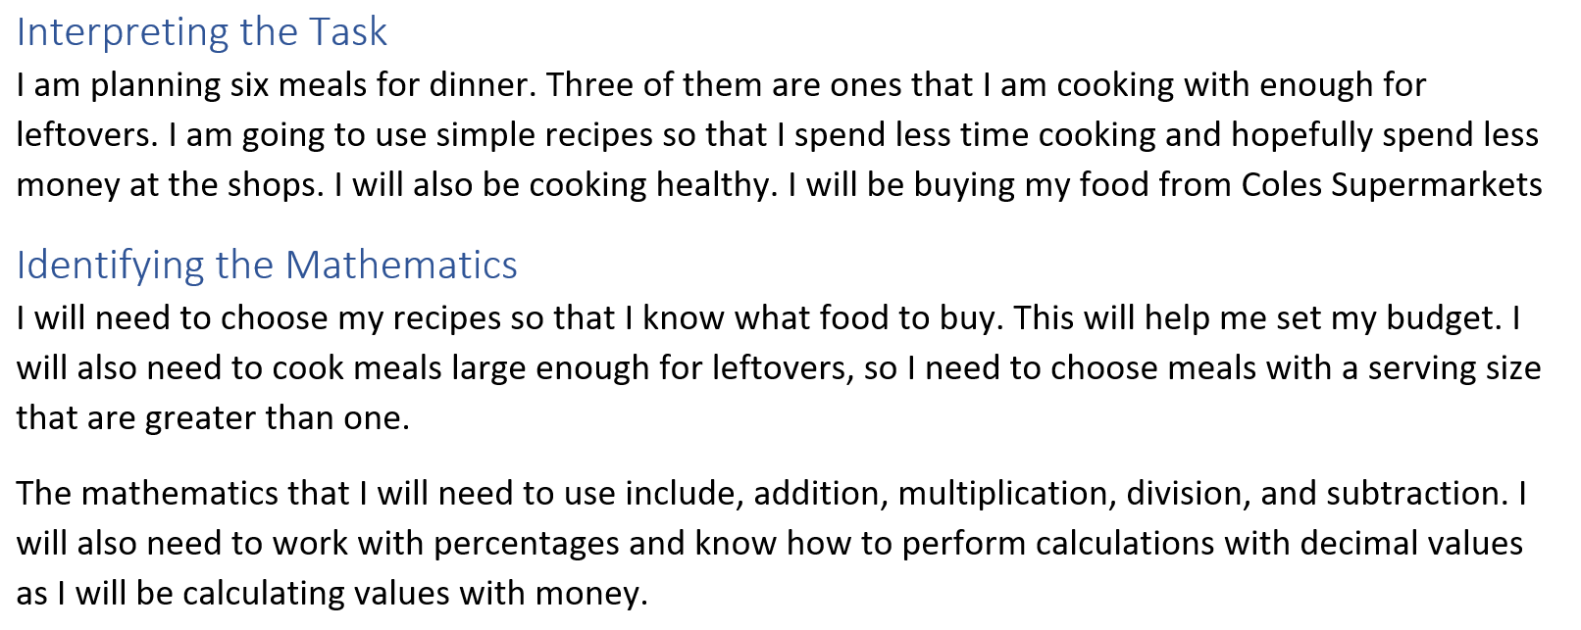
Example Answer – Interpreting the task and identifying the mathematics
Notes:
Most assumptions are made. One key assumption has been left out, the number of people that require dinner. This has not been stated in the question. It needs to be defined clearly.
There are no assumptions of what is already in the kitchen like the basics, oil, salt, range of existing herbs and spices.
There is also no assumption made about how much is being earned per week or what percentage of the weekly earnings will be set aside for food. There is no gauge for what may be affordable or achievable.
Discuss how a weekly income could be estimated and what would seem like a reasonable amount of income that is spent on food.

Slide 6
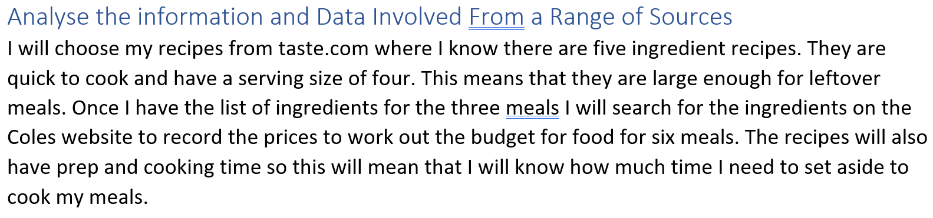
Example Answer – Analyse information and data from a range of sources
Notes:
No reason given why Coles is chosen over other grocery outlets and sources. A best buy analysis is required.

Slide 7
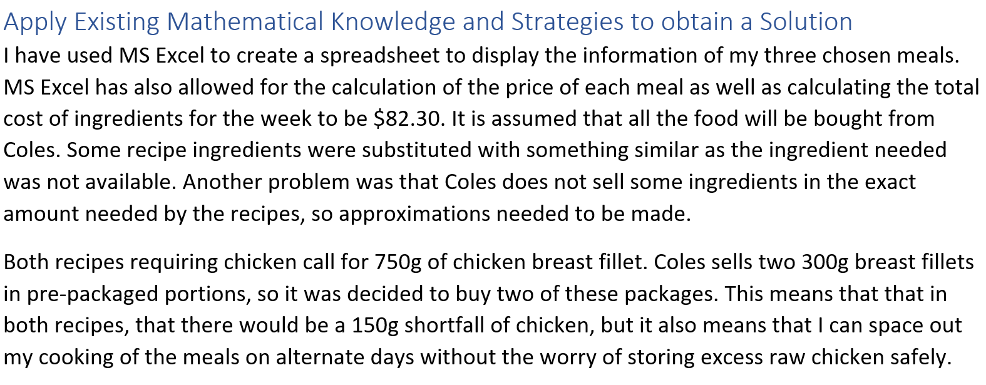
Example Answer – Apply existing mathematical knowledge and strategies
Notes:
Other calculations that can be shown:
Best Buy
If the number of people being fed had a value, the exact number of meals could be calculated
There is no discussion of what will be done with the leftover dried goods. They can be used in future meals which can mean future food bills will be less moving forward.

Slide 8
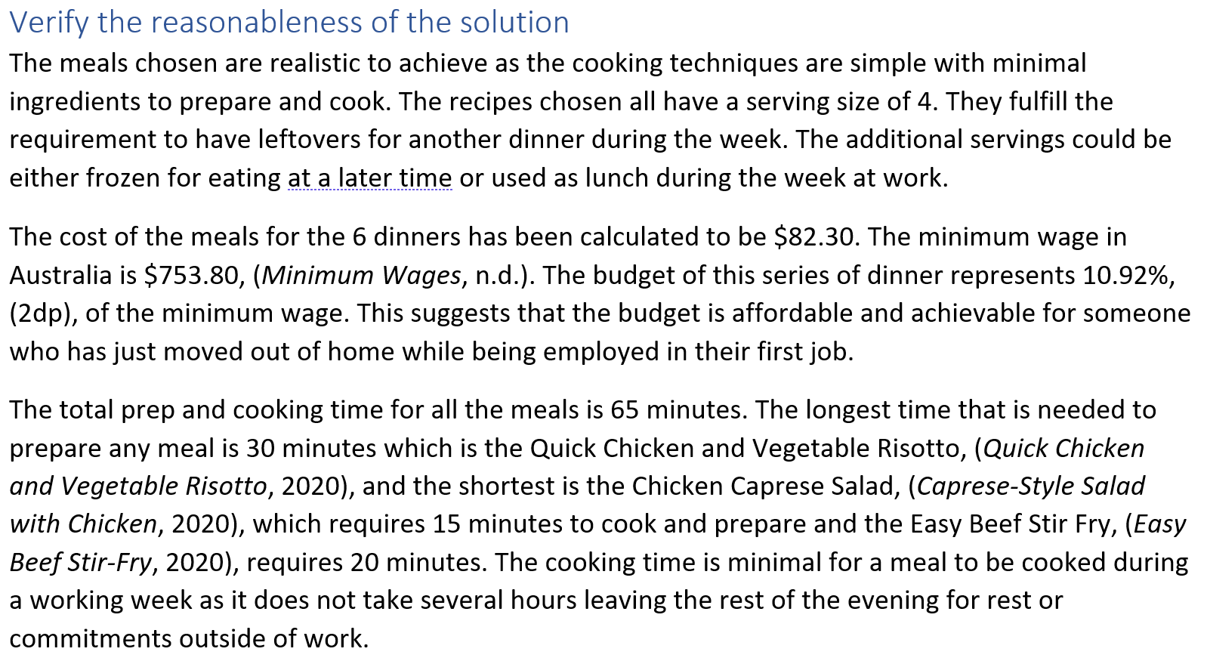
Example Answer – Verify reasonableness of solution
Notes:
Considers real life aspects like the working week. Again, this assumption could have been in the introduction with a hypothetical job and expected earning income as well as the hours worked.
Sources of information are referenced
Specific calculated values are included in the answer

Slide 9
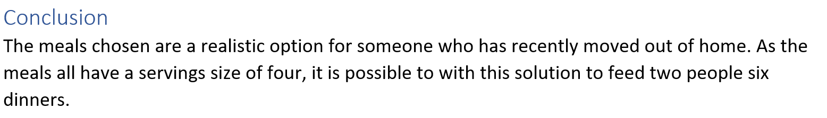
Example Answer - Conclusion
Notes:
Good point
Clear statement
Not so good point
- Has information in the statement that has not been supported by mathematical calculations or any detailed mention of this in the report.

Slide 10
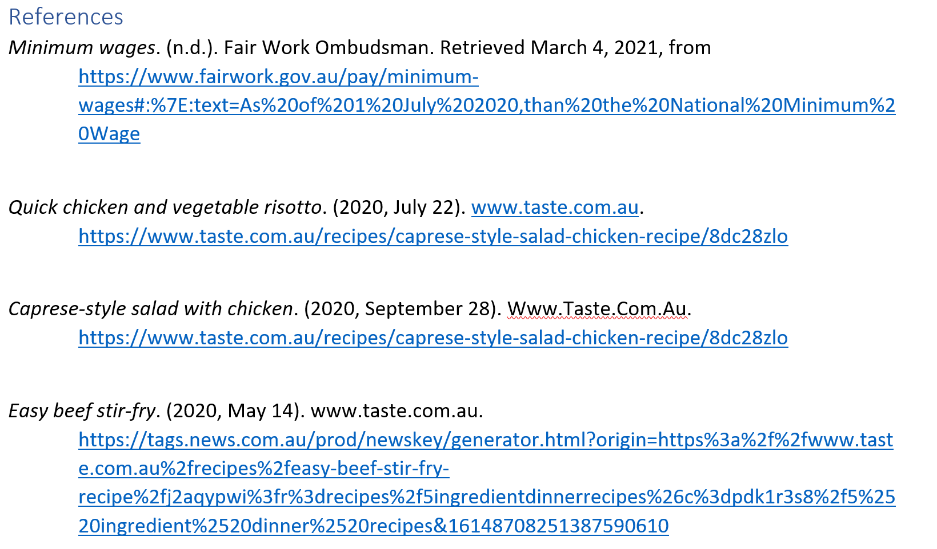
Example Answer - References
Notes:
References must be included to show where information was researched from and also where numerical values have been obtained.
Obvious reference not included, Coles.

